Slide 1

Team
NOCK
Nathan Davids
Okuhle Charlieman
Cole Hanekom
Kiran Isaacs

Slide 2

02
03
04
05
06
07
INTRODUCTION
LIST OF
CONTENTS
FILE OBJECTS
FORM DATA
FETCH: CROSS-ORIGIN REQUESTS
PATTERNS AND FLAGS
CONCLUSION
The content that will be spoken about
throughout the course of this
presentation.

Slide 3

01
02
A file object inherits from Blob
and is extended with filesystem
related capabilities.
FILE
OBJECTS
There are two ways to obtain it.
1. new File(fileParts, fileName,
[options])
2. drag’n’drop
03 FileReader objects can
read from a file in one of
three formats:
(readAsText).
(readAsArrayBuffer).
(readAsDataURL).

Slide 4
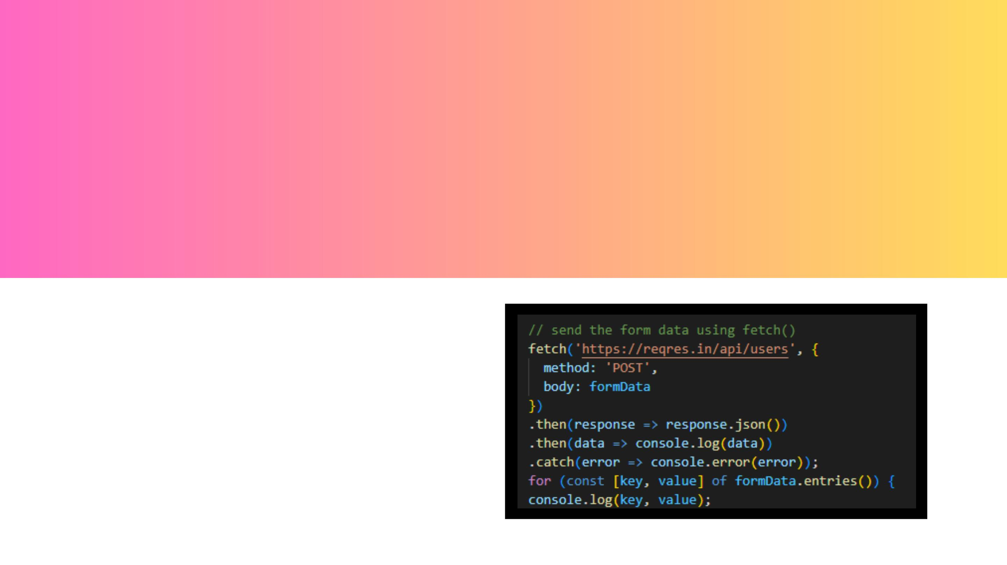
FORM DATA
FormData() is a built-in
JavaScript object that
allows you to easily
construct and send form
data to the server using
the fetch() API

Slide 5
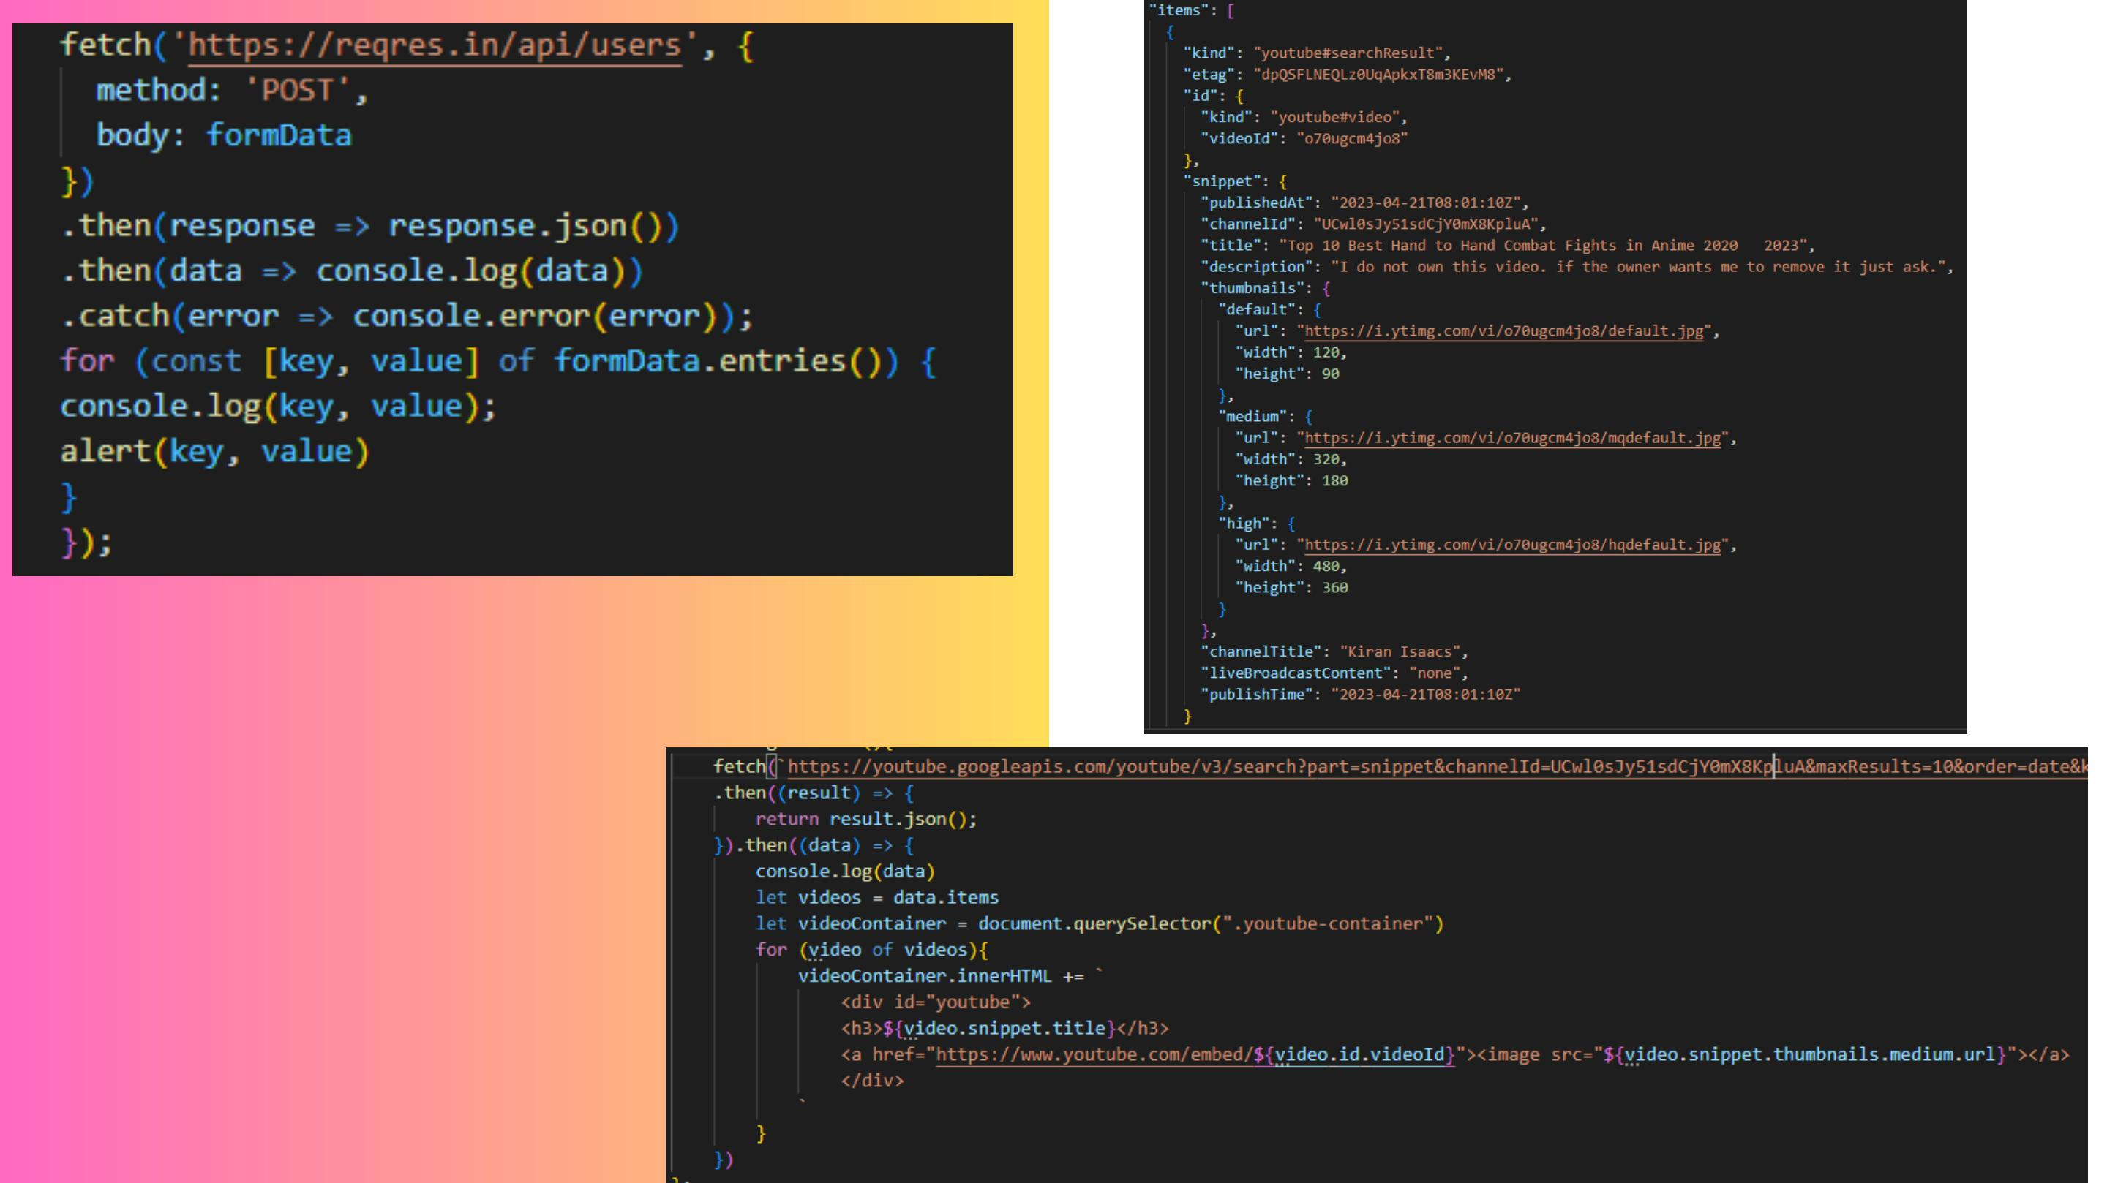
CROSS-
ORIGIN
REQUESTS

Slide 6

PATTERNS
a pattern is a regular expression that
defines a specific format for data input
validate or match user Input
FLAGS
PATTERNS &
FLAGS
a flag is a modifier that can be added to
a regular expression to change its
behavior
Flags are used to perform advanced text
search and manipulation.
IMPLEMENTATION
PATTERN = TEXT HIGHLIGHT
FLAG(S) = G AND I

Slide 7

MZAMOMTSHA
WEBSITE

Slide 8

THANK
YOU!
ANY QUESTIONS?

